Slide 1
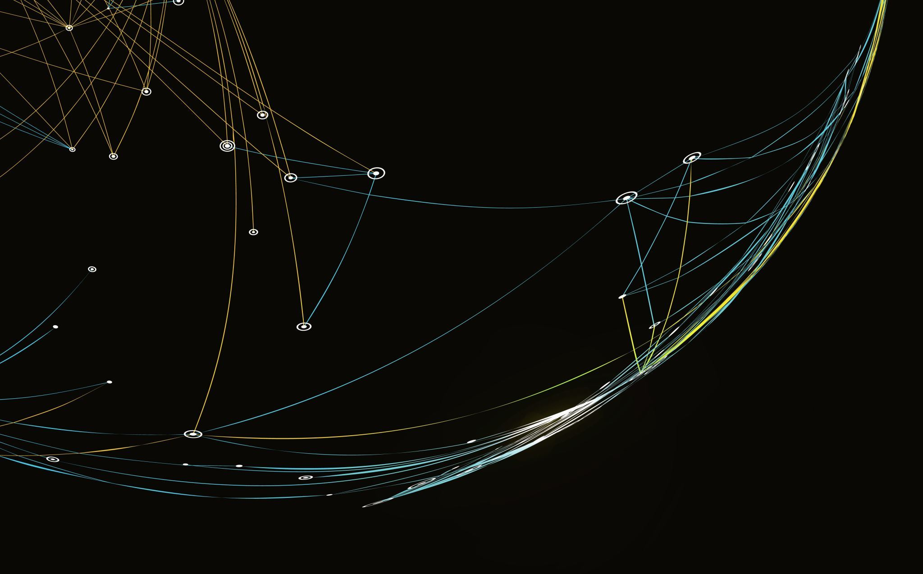
Analyzing the Viability of Blockchain-based Secure Data Routing in Dynamic SDNs

Slide 2
Introduction
Background:
Modern networks face rising cybersecurity threats due to increased connectivity and sophisticated attacks.
Traditional network management approaches struggle to keep pace with dynamic and evolving threats.
Technological Context:
Software-Defined Networking (SDN) enables centralized, programmable network control, enhancing agility.
Machine Learning (ML) provides intelligent anomaly detection and traffic prediction capabilities.
Blockchain ensures secure, transparent, and immutable logging of network decisions.
Importance of Integration:
Combining SDN, ML, and Blockchain creates a robust, adaptive, and secure network management system.

Slide 3
Aim and Objectives
The main focus of this research is to compare the approaches of integrating blockchain technology and machine learning to address the issue of data routing that is proactive and secure in unpredictable Software-Defined Networks (SDNs).
To investigate the underlying principles and current state of blockchain technology, SDNs, and machine learning, and explore their potential integration for secure data routing.
To develop a blockchain-based framework that incorporates machine learning techniques to optimize data routing and enhance security in dynamic SDNs.
To evaluate the performance implications of integrating blockchain and machine learning in SDNs, focusing on metrics such as latency, scalability, and resource utilization.
To design and implement machine learning models that can adapt to real-time changes in SDN topology and conditions, ensuring consistent security and efficiency.
To analyze the trade-offs between security, performance, and scalability in the proposed blockchain and machine learning-based framework.
To identify practical challenges in the deployment of the proposed framework in dynamic SDNs and suggest strategies for overcoming these challenges.

Slide 4
Research Questions
1. To which extent, it is possible to incorporate blockchain in SDNs for enhancing the data routing security in dynamic setting?
2. What is the part that machine learning can play to further improve and secure the data routing in SDNs using blockchain technology?
3. What are the possible performance consequences from integrating the blockchain with machine learning for secure data transmission in dynamic SDNs?
4. What strategies can be used to train and apply machine learning in real-time to changes in the topology and operating conditions of block chain secured SDNs?
5. Along with that, not less attention should be paid to such an important aspect of distributed computing as optimization choices, such as prioritization of security or machines’ performance, etc when it comes to blockchain and machine learning-based solution for dynamic SDNs.
6. What is the pragmatic consideration of the use of the blockchain and machine learning based security framework used in the dynamic SDNs and how each can be addressed?

Slide 5
Literature Reviews
SDN in Network Management: Research shows SDN enhances network control and flexibility but lacks built-in security measures, making it vulnerable to attacks.
Machine Learning in Cybersecurity: Widely used for anomaly detection and traffic prediction, offering proactive threat identification but often disconnected from real-time network control.
Blockchain for Security: Provides an immutable and decentralized method for logging decisions, enhancing security and auditability but faces scalability and latency issues.
Existing Integration Gaps: Few studies combine SDN, ML, and Blockchain, leaving a gap in real-time, secure, and adaptive network management solutions.
Need for Holistic Solutions: Emphasizes the need for integrated approaches that address security, efficiency, and real-time adaptability in dynamic network environments

Slide 6
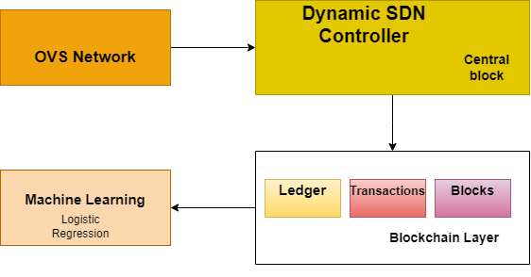
Methodology
Framework for Secure Data Routing in Dynamic SDNs using Blockchain and Machine Learning:
OVS Network (Open vSwitch Network):
Acts as the underlying infrastructure to manage and direct network traffic within the Software-Defined Network (SDN).
Communicates with the Dynamic SDN Controller to manage data flow.
Dynamic SDN Controller:
Central component that dynamically manages and controls the network flow in the SDN.
Sends routing instructions to the OVS Network and interacts with the Blockchain Layer for secure data transmission.
Blockchain Layer:
Ledger:
Stores a record of all transactions and data flow within the network in an immutable format.
Transactions:
Records data routing decisions, ensuring secure and transparent transaction logging.
Blocks:
Groups of transactions are bundled into blocks to ensure data integrity, preventing tampering and enhancing security across the network.
Machine Learning (Logistic Regression):
Utilized to predict and optimize data routing paths in real-time.
Receives data from the SDN Controller and analyzes it to improve routing efficiency and security.
Works in conjunction with the Blockchain Layer to ensure the routing decisions are secure and proactive.
Overall Interaction:
The Dynamic SDN Controller monitors and manages the network flow.
Machine Learning (Logistic Regression) predicts optimal routing and sends decisions back to the SDN Controller.
The Blockchain Layer ensures secure, tamper-proof recording of all routing actions and decisions in the network.

Slide 7
Implementation
Tools and techniques used in your research
Component | Tool/Technique | Description
SDN Controller | Python (Mininet, Ryu/POX/ONOS) | Used for setting up and configuring the SDN controller, allowing network simulation and control of traffic flows.
Blockchain Integration | Python (Web3.py, Hyperledger SDK) | Implemented blockchain-based secure data routing, smart contracts for decision-making, and maintaining a distributed ledger of routing decisions.
Machine Learning | Python (Scikit-learn, Pandas) | Logistic regression model developed for anomaly detection and traffic prediction, trained, tested, and evaluated using relevant metrics.
Data Visualization | Python (Matplotlib, Seaborn) | Visualization of data patterns, feature importance, model performance metrics, and blockchain transaction flows.
API Integration | Python (Flask, REST API) | Facilitated the communication between SDN controller, ML model, and blockchain, ensuring seamless data exchange and decision-making in the system.
Data Preprocessing | Python (Pandas, NumPy) | Preprocessed and standardized data sets to prepare them for ML model training and testing.

Slide 8

Implementation
ML Model Training:
Logistic regression model development for anomaly detection.
Standardization and train-test split of datasets.
Blockchain Integration:
Smart contracts for decision validation.
Transaction batching and optimized proof-of-work.
SDN Controller Integration:
RESTful APIs for real-time interaction.
Logging and validating routing decisions.

Slide 9
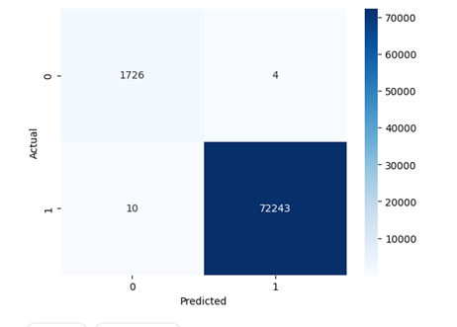
Results
High Detection Accuracy: The implemented logistic regression model achieved a high accuracy rate of 99.93%, indicating its effectiveness in distinguishing between normal and anomalous traffic.
Blockchain Enhancements: Optimized blockchain integration with transaction batching and simplified proof-of-work, reducing computational overhead and improving processing speed.
Secure Data Routing: The integration of Blockchain with SDN ensured secure, tamper-proof routing decisions, enhancing network security and transparency.
Performance Evaluation: The system demonstrated efficient real-time anomaly detection and secure decision validation, showing improved performance over traditional network management methods.

Slide 10
Discussion
Comparison with Previous Research
Study | Accuracy | Precision | Recall | F1 Score | Techniques | Dataset
Our Study | 0.9993 | 0.9998 | 0.9996 | 0.9997 | Logistic Regression, SDN, Blockchain | Custom Network Dataset
(Hamarsheh, 2024) | 0.9700 | 0.9600 | 0.9650 | 0.9625 | Random Forest, SDN | KDD Cup 99 Dataset
(Hanif, 2024) | 0.9650 | 0.9550 | 0.9600 | 0.9575 | Support Vector Machine, SDN | NSL-KDD Dataset
(Decision Tree, 2024) | 0.9500 | 0.9400 | 0.9450 | 0.9425 | Decision Tree, SDN | UNSW-NB15 Dataset
(Saveetha, 2023) | 0.9550 | 0.9450 | 0.9500 | 0.9475 | Gradient Boosting, SDN | CICIDS 2017 Dataset

Slide 11
Conclusions and future Work
The integration of SDN, ML, and Blockchain significantly improved network security, enabling real-time anomaly detection and secure data routing.
The logistic regression model provided high accuracy, precision, and recall, proving effective for traffic anomaly detection and prediction.
Blockchain's use of smart contracts and tamper-proof ledger ensured scalable and transparent routing decisions, enhancing network trustworthiness.
Optimizations to the blockchain, such as simplified proof-of-work and transaction batching, minimized processing delays, making the system suitable for real-time applications.
The overall system demonstrated robust integration, leveraging the strengths of SDN, ML, and Blockchain to create a dynamic and secure network management framework.
Plan for deployment in larger, real-world network environments to validate the system's scalability and effectiveness.
Extend the framework to support IoT environments, focusing on secure, energy-efficient, and low-latency network management for resource-constrained devices.

Slide 12
References
Abou El Houda, Z. H. A. a. K. L., 2023. Mitfed: A privacy preserving collaborative network attack mitigation framework based on federated learning using SDN and blockchain. IEEE Transactions on Network Science and Engineering, 10(4), pp.1985-2001..
Alkhamisi, A. K. I. a. B. S., 2024. Blockchain-Based Control Plane Attack Detection Mechanisms for Multi-Controller Software-Defined Networks. Electronics, 13(12), p.2279..
Apruzzese, G. L. P. M. d. O. E. M. W. B. R. L. G. A. a. D. F. F., 2023. The role of machine learning in cybersecurity.. Digital Threats: Research and Practice, 4(1), pp.1-38..
Arif, M. W. G. G. O. B. V. T. P. B. A. a. C. J., 2020. SDN-based vanets, security attacks, applications, and challenges.. Applied Sciences, 10(9), p.3217..
Awan, S. J. N. U. S. K. A. Q. A. a. C. J., 2022. Blockchain based secure routing and trust management in wireless sensor networks.. Sensors, 22(2), p.411..
Bhandari, A. C. A. a. K. F., 2023. Machine learning and blockchain integration for security applications. In Big Data Analytics and Intelligent Systems for Cyber Threat Intelligence (pp. 129-173). River Publishers..
Bonanni, M. C. F. F. R. a. P. L., 2023. Dynamic control architecture based on software defined networking for the internet of things.. Future Internet, 13(5), p.113.`.
Boualouache, A. a. E. T., 2022. A survey on machine learning-based misbehavior detection systems for 5g and beyond vehicular networks.. IEEE Communications Surveys & Tutorials, 25(2), pp.1128-1172..
Decision Tree, S., 2024. GATE-BC: Genetic Algorithm-Powered QoS-Aware Cross-Network Traffic Engineering in Blockchain-Enabled SDN. IEEE.
Dhurandher, S. S. J. N. P. K. R. a. G. G., 2022. A blockchain-based secure routing protocol for opportunistic networks. ournal of Ambient Intelligence and Humanized Computing, 13(4), pp.2191-2203..
Hamarsheh, A., 2024. An Adaptive Security Framework for Internet of Things Networks Leveraging SDN and Machine Learning. Applied Sciences, 14(11), p.4530..
Hanif, M., 2024. BUILDING RESILIENCE IN IoT: SDN AND BLOCKCHAIN-BASED DEFENSE AGAINST DDoS ATTACKS.

Slide 13

Thankyou

Slide 14

Any questions?

